Slide 1
Chapter 40 Preserving Biodiversity
UNIT 7 CHAPTER 39
LIU Yang

Slide 2

LEARNING OUTLINE
40.1 Earth's Biodiversity Is Dwindling
40.2 Many Human Activities Destroy Habitats
40.3 Pollution Degrades Habitats
40.4 Global Climate Change Alters and Shifts Habitats
40.5 Exotic Invaders and Over exploitation Devastate Many Species
40.6 Some Biodiversity May Be Recoverable

Slide 3
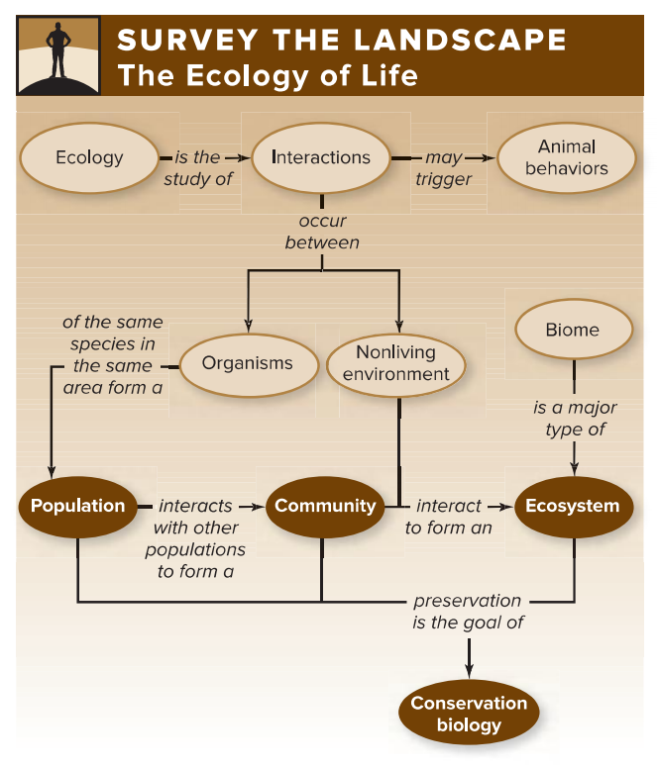

Slide 4
40.1 Earth's Biodiversity Is Dwindling
For more than 3 billion years,evolution has produced an extraordinary diversity of life,both obvious and unseen. Humans simply cannot live without these other species.We use other organisms for food, shelter, energy, clothing,and drugs. Microbes carry out indispensable tasks, including digesting food in our intestines,decaying organic matter in soil, fixing nitrogen, and producing oxygen(O₂). Plants and microbes absorb carbon dioxide(CO₂) and purify the air, soil, and water. Wetland plants reduce the severity of floods.Insects pollinate our crops.The remains of species that lived millions of years ago provide the fossil fuels that sustain our economies.The list goes on and on.
Clearly,our existence as a species depends on biodiversity—the variety of life on Earth.Biologists measure biodiversity at three levels:genetic, species, and ecosystem. Genetic diversity is the amount of variation that exists within a species.This aspect of biodiversity is essential for populations to adapt to changing conditions.The next level,species diversity, accounts for the number of species that occupy the biosphere. Finally,ecosystem diversity means the variety of ecosystems on Earth, such as deserts,rain forests,grass-lands,and mountaintops.

Slide 5
40.1 Earth's Biodiversity Is Dwindling
Extinction means that the last individual of a species has perished. An endangered species （濒危物种）has a high risk of extinction in the near future,and a vulnerable species is likely to become extinct in the more distant future.
Conservation biologists study the preservation of biodiversity at all levels.These scientists try to determine why species disappear,and they develop strategies for maintaining diversity.This final chapter focuses first on the main causes of the loss of biodiversity:habitat destruction and degradation, nonnative species,and over exploitation. Each of these threats to biodiversity is intimately related to the ever-expanding human population,and the problems will only become worse as our population continues to grow. Nevertheless,the chapter ends on a hopeful note, with some ways people can help counteract the biodiversity crisis.

Slide 6
FIGURE IT OUT
Which of the following is NOT one of the main causes of today's biodiversity crisis?
a.Natural disasters,such as earthquakes b.Habitat destruction and degradation
c.Over exploitation d.Introduction of nonnative species

Slide 7
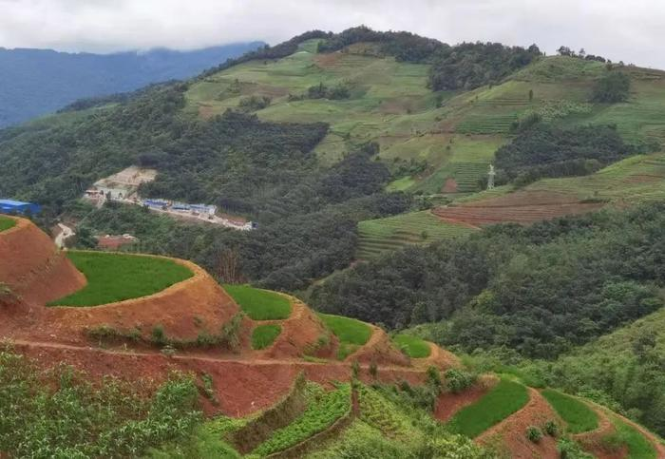
40.2 Many Human Activities Destroy Habitats
Habitat destruction is the primary threat to biodiversity.Humans have altered more than 50%of the land, replacing prairies,wetlands,and forests with farms,range land,and cities.
One form of habitat destruction is deforestation, the removal of all trees from a forested area. Like all plants,trees absorb CO₂from the atmosphere and use it in photosynthesis,a process that also releases O₂.The wood of a living tree is an important long-term“carbon sink”that helps offset CO₂ released when humans burn fossil fuels.Trees also play a critical role in the water cycle,returning water to the atmosphere via transpiration. Forests harbor a tremendous diversity of organisms that provide wildlife habitat and supply many of the resources that we use every day; deforestation eliminates these resources. In addition,forest destruction removes the upper layer of organic matter on the forest floor,so rainwater enters streams rather than soaking into the soil.As the soil erodes away,waterways become choked with nutrients and sediments.
All of the world's forest biomes are under threat.Logging,mining,and exploration for oil and gas are rapidly depleting the northern coniferous forest.In addition,nearly all of the world's native temperate forests are already gone.In North America,for example,people have cleared the land to create farmland,obtain fuel,and make room for cities.Today,less than 1%of the original temperate forest survives.

Slide 8
40.2 Many Human Activities Destroy Habitats
Prairies and other temperate grasslands have also disappeared as the human population has expanded. Grassland soils are among the most fertile in the world,and their rolling hills are ideal for cultivation.Forests and grasslands are shrinking worldwide,but deserts are expanding as unsustainable agriculture eats away at forests and savannas. But human activities can also destroy native deserts. Desert cities such as Phoenix,Las Vegas,and Palm Springs demand huge amounts of water for household use,irrigation,and recreation.The water comes from faraway rivers,changing the desert ecosystem and reducing the river's flow.
Freshwater habitats in general are vulnerable to destruction. Damming completely alters river ecosystems.Deep reservoirs replace waterfalls, rapids ,and wetlands,where birds and many other species breed. Areas that were once seasonally flooded become dry.Water temperature, Oxygen content,and nutrient levels all change,triggering shifts in food webs above and below the dam.Dams also disrupt the migration of fishes and other aquatic animals.
Another threat to freshwater biodiversity is alterations to a river's path.Fast moving water, in turn,erodes nutrient-rich sediments.These sediments,which once spread over flood-plains during periodic floods,now remain in the river.Once the nutrients arrive at the Gulf they stimulate the growth of algae,causing the additional problems. Coastlines are also suffering from habitat destruction. Yet humans have drained and filled estuaries for urbanization,housing,tourism,dredging,mining,and agriculture.These activities affect life in the oceans,too.The loss of coastal habitats can threaten populations of marine animals such as blue fin tuna,grouper,and cod.These problems are only expected to get worse.

Slide 9
FIGURE IT OUT
Which human activity has been the most harmful to biodiversity intropical forests?
a.Housing b.Agriculture c.Transportation d.Tourism

Slide 10
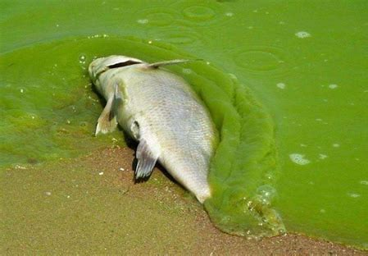
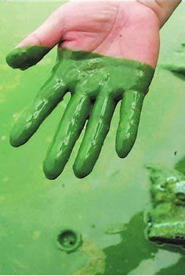
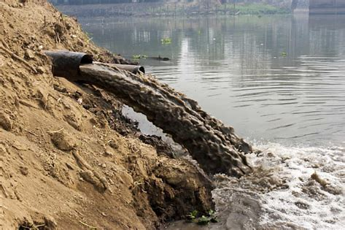
40.3 Pollution Degrades Habitats
A.Water Pollution Threatens Aquatic Life
A diverse array of pollutants affects rivers,lakes,and groundwater. Raw sewage can also be a major pollutant. In addition to carrying disease-causing organisms,sewage also contains organic matter and nutrients such as nitrogen and phosphorus.When released into waterways,organic matter fuels the growth of bacteria, whose respiration depletes the water of oxygen. Fish and other organisms die. Meanwhile, in a process called eutrophication,nutrients from the sewage fertilize phytoplankton in the water.The resulting algae blooms are unsightly. Moreover,when the algae die,the microbes that decompose their dead bodies further deplete dissolved oxygen in the water. Fertilizer and animal wastes that enter waterways also cause eutrophication.For example, nutrients from agricultural and urban lands drained by the Mississippi River find their way into the Gulf of Mexico.There,the nutrients fuel algae blooms.On a local scale,toxins from the algae may kill fishes,manatees,and other sea life.A larger-scale problem,however,is the oxygen-depleted zone that forms each summer near the seafloor off the coast of Louisiana.The seasonal lack of oxygen in this“dead zone”kills many animals,disrupting not only the Gulf's food web but also its economy.

Slide 11
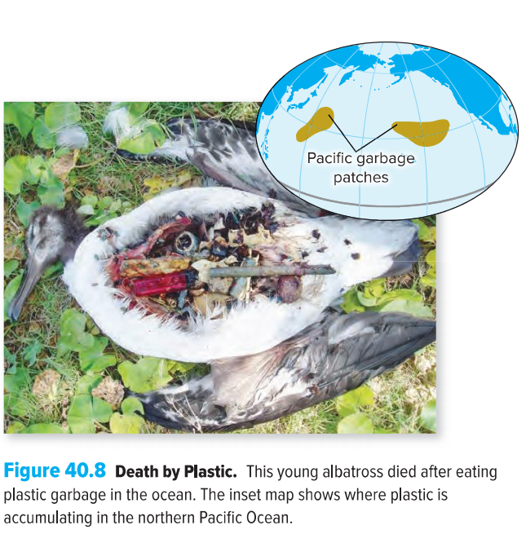
40.3 Pollution Degrades Habitats
A.Water Pollution Threatens Aquatic Life
Toxic chemicals and trash also pollute the open ocean. For example,ocean currents have concentrated millions of tons of plastic into two huge,interconnected“garbage patches”in the northern Pacific.Floating just below the water surface are tiny pellets,called“nurdles(塑料球),”that form when plastic debris disintegrates.Fishes,sea turtles,and sea birds mistake the plastic for their natural food.The pellets can lodge in intestines and kill the animals outright,or chemicals from the plastic may accumulate in their tissues.
The chemicals leached from plastic are a small subset of human-made persistent organic pollutants, carbon-containing molecules that do not degrade (or that degrade extremely slowly). Many pesticides fall into this category,as do some solvents and pharmaceutical drugs.These substances contaminate ecosystems over long periods. Some of these compounds cause cancer; others are hormone mimics that disrupt reproduction. Because they do not biodegrade,these fatsoluble chemicals become more concentrated as they ascend the food chain.This process,called biomagnification, accounts for the high concentrations of toxic chemicals in the fatty tissues of tunas,polar bears,and other top predators. Organisms living in polluted areas are often exposed to several pollutants at once.

Slide 12
FIGURE IT OUT
What is the connection between agriculture in the midwestern UnitedStates and the Gulf of Mexico's“dead zone”?
a.Pesticides from farmlands are killing ocean life.
b.Nutrient enrichment causes oxygen depletion in Gulf waters
c.River sediments block out the light needed for photosynthesis in the Gulf.
d.Farmlands use up all of the nitrogen in the water,so the Gulf waters are starved for nutrients

Slide 13
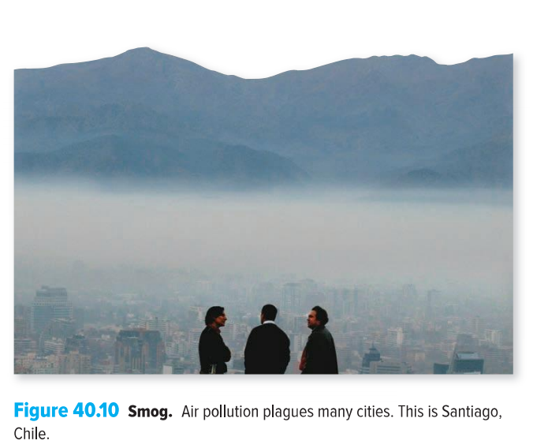
40.3 Pollution Degrades Habitats
B.Air Pollution Causes Many Types of Damage
Smog is a type of air pollution that forms a visible haze in the lower atmosphere.Industrial smog occurs in urban and industrial regions where power plants,factories, and households burn coal and oil. The resulting smoke and sulfur dioxide (SO₂)may form a dark haze. Photochemical smog forms when nitrogen oxides and emissions from vehicle tailpipes undergo chemical reactions in the presence of light, producing 0zone(O₃)and other harmful chemicals that injure plants and cause severe respiratory problems in humans.Warm,sunny areas with heavy automobile traffic have the most photochemical smog,but winds may carry the pollutants to sparsely populated areas.
Air also carries suspended particulates,tiny bits of matter that float in the air.Examples include road dust, volcanic ash, soot from partially burned fossil fuels,mold spores, pollen, and acidic particles. The damage they cause extends beyond the occasional need to dust off bookshelves and window sills. Most harmful are particles that are 2.5 μm in diameter or smaller. Not only do they become trapped deep within the lungs, but the heavy metals and toxic organic compounds in these particles make them especially likely to trigger inflammation, shortness of breath,asthma,or even cancer.

Slide 14
40.3 Pollution Degrades Habitats
B.Air Pollution Causes Many Types of Damage
Other forms of air pollution are less visible but perhaps more harmful than smog. One example is acid deposition:acidic rain,snow,fog,dew,or dry particles. Because the atmosphere contains CO₂and water, all rainfall includes some carbonic acid(H₂CO₃)and is therefore slightly acidic,with a pH around 5.6. The combustion of fossil fuels,however,releases sulfur and nitrogen oxides(SO₂and NO₂)into the atmosphere.These compounds react with water,forming sulfuric acid and nitric acid.The acids return to the Earth as acid deposition.Coal-burning power plants release the most sulfur and nitrogen oxides,although emissions of these pollutants have declined since the 1980s .In the United States,winds carry airborne acids hundreds of miles east and northeast of the power plants in the Midwest. As a result, rainfall in parts of the eastern United States has a pH of about 4.7. Most lakes have a pH between 6 and 8;acid deposition can lower it to 5 or less.The acid leaches toxic metals such as aluminum or mercury from soils and sediments, causing fish eggs to die or yield deformed offspring. Organisms that feed on the doomed species must seek alternative food sources or starve,which disrupts or topples food webs. Eventually,lake life dwindles to a few species that can tolerate increasingly acidic conditions.Acid deposition alters forests,too.As soil pH drops,aluminum ions released from soil enter roots and stunt tree growth.Affected trees become less able to resist infection or to survive harsh weather.

Slide 15
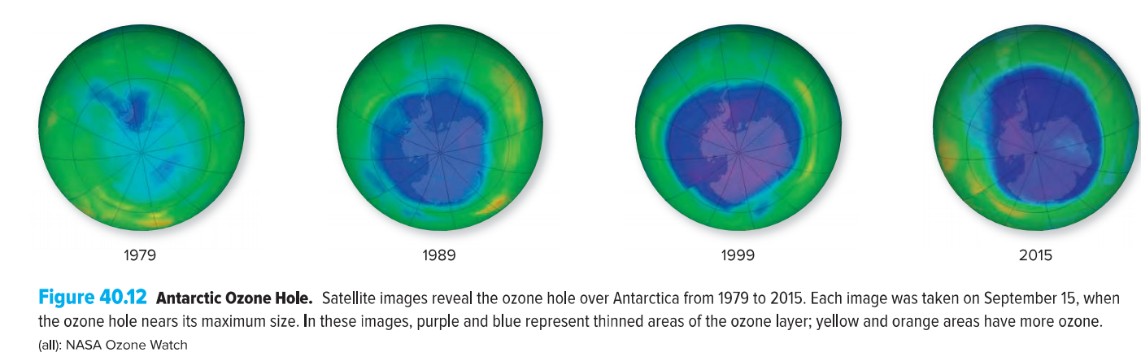
40.3 Pollution Degrades Habitats
B.Air Pollution Causes Many Types of Damage
Chemicals that destroy ozone can also be extremely harmful air pollutants. Ozone is an atmospheric molecule with two faces.As we have already seen,ozone in photochemical smog at Earth's surface is harmful.In the upper atmosphere,however,the stratospheric ozone layer blocks damaging ultraviolet (UV) radiation from the sun.Located about 10 to 50 kilometers above Earth's surface,the ozone layer forms when UV radiation from the sun reacts with oxygen gas(O₂).UV radiation damages biological molecules such as DNA,causing genetic mutations.The stratospheric ozone layer thus protects organisms from much of the harmful radiation that would otherwise strike Earth.

Slide 16
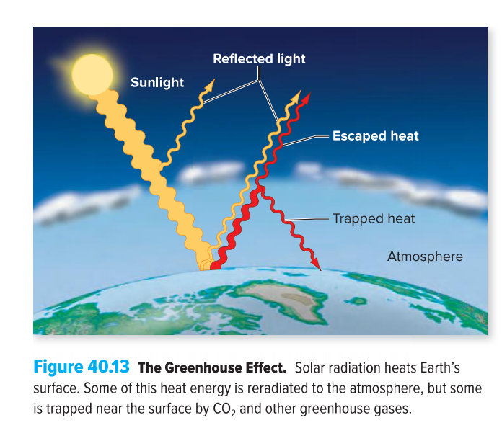
40.4 Global Climate Change Alters and Shifts Habitats
A.Greenhouse Gases Warm Earth's Surface
CO₂ is a colorless,odorless gas present in the atmosphere at a concentration of about 400 parts per million.Although it makes up a tiny fraction of the atmosphere,CO₂ is one of several gases that contribute to the greenhouse effect,an increase in surface temperature caused by heat-trapping gases in Earth's atmosphere.Sunlight passes through the atmosphere and reaches Earth's surface.Some of the energy is reflected,but some is absorbed and reradiated as heat.Greenhouse gases block the escape of this heat from the atmosphere,just as transparent panes of glass trap heat inside a greenhouse.Carbon dioxide is one greenhouse gas;others include methane,nitrous oxide (N₂O),and CFCs.Livestock and landfills release methane,and nitro-gen fertilizers are a major source of N₂O.These other gases actually trap heat much more efficiently than does CO₂,but because they are less abundant,they contribute only half as much to the greenhouse effect.In a sense,the greenhouse effect supports life,because Earth's average temperature would be much lower without its blanket of greenhouse gases.And greenhouse gases have many sources—including volcanoes—that have nothing to do with our actions.

Slide 17
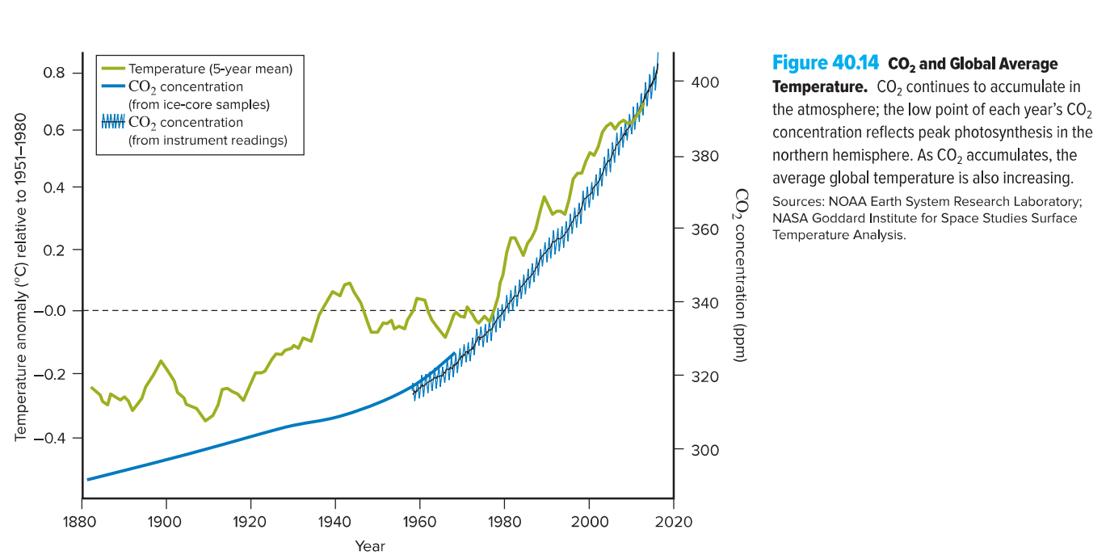
40.4 Global Climate Change Alters and Shifts Habitats
A.Greenhouse Gases Warm Earth's Surface
But CO₂ has been steadily accumulating in the atmosphere for the past century,largely due to human activities.The primary culprit is the use of fossil fuels such as coal,oil,and gas.Tropical deforestation and other combustion activities also add a share.All together,human activities release some 38 billion metric tons of CO₂into the atmosphere each year.Photosynthesis temporarily removes some of this carbon from the atmosphere and incorporates it into plant tissues.Overall,however,more CO₂is added than is removed.
This accumulation of CO₂—along with climbing levels of other greenhouse gases—was accompanied by an increase in average global temperatures in the 20th century.Climate models predict that these trends will continue unless we take immediate action.The United Nations Climate Change Conference in 2015 laid the groundwork for change,with 196 nations agreeing to hold the increase in global temperature below 2℃ and to balance greenhouse gas emissions with removals before 2100.Earth's average temperature is rising overall,but some areas will become warmer and others will become cooler.The commonly used phrase“global warming”is therefore somewhat misleading. Global climate change is a more accurate term for past and future changes in Earth's weather patterns.

Slide 18
40.4 Global Climate Change Alters and Shifts Habitats
B.Global Climate Change Has Severe Consequences
Earth's gradual warming that has already occurred has been associated with many measurable effects, including the shrinking of alpine glaciers and polar ice sheets.This process is self-reinforcing.
When floating sea ice melts,sea level does not rise (just as ice melting in a full glass of lemonade does not cause the liquid to overflow).However,the loss of ice over land—such as the ice covering Greenland and Antarctica—has contributed to a rise in sea level.This change could eventually alter the ocean ecosystem and flood coastal cities.
Weather conditions in tropical and temperate regions are also changing,thanks in part to a rise in sea surface temperature. In the tropics,warmer water means higher winds and more evaporation, which increase the amount of rainfall in a severe storm.In dry areas,on the other hand,global climate change may mean more intense and longer droughts, fewer cold snaps, and more heat waves.
These changes kill some organisms outright,whereas others become stressed and vulnerable to disease.Continued climate change will affect not only wild organisms but also agriculture and public health. Drought-related water shortages may affect more than a billion people.Tropical diseases such as malaria may move into temperate areas. Ocean life is also vulnerable to CO₂accumulation.One problem is that CO₂buildup causes ocean water to become more acidic.

Slide 19
FIGURE IT OUT
Why is deforestation associated with global climate change?
a.Because the loss of forest animals reduces the CO₂ released into the atmosphere
b.Because the loss of trees reduces the amount of photosynthesis occurring on the planet
c.Because the loss of forest makes more land available for agriculture
d.Because the loss of tree root systems leads to erosion

Slide 20
40.5 Exotic Invaders and Over exploitation Devastate Many Species
A.Invasive Species Displace Native Organisms
An introduced species (also called a nonnative,alien,or exotic species)is one that humans bring to an area where it did not previously occur.This transport may seem harmless at first, and many introduced species die.Even if they survive in their new homes,they may not cause problems. For example,the house sparrow was introduced to the United States from Europe in the 1850s.In addition,at least 5000 nonnative plant species live in U.S.ecosystems,introduced from agriculture and urbanization.To be considered invasive,an introduced species must begin breeding in its new location and spread widely from the original point of introduction.A species is likely to meet this criterion if its new habitat is similar to its old home,only without natural predators.In addition, according to some definitions,the species must harm the environment,human health,or the economy. A nonnative species not only changes the composition of a community but also may carry diseases that spread to native species.The economic costs include everything from the purchase of herbicides that kill invasive weeds,to the loss of grain eaten by hungry birds and rodents,to declining tax revenue when invasive aquatic plants interfere with boating and recreation.

Slide 21
40.5 Exotic Invaders and Over exploitation Devastate Many Species
B.Over exploitation Can Drive Species to Extinction
Another cause of species extinction is over exploitation:harvesting the members of a species faster than they can reproduce.
Many of the most famous examples of species extinctions result from over hunting of terrestrial animals.The dodo,for example,was a flightless bird that once lived on the Indian Ocean island of Mauritius.In the late 17th century,humans hunted the dodo for food while introducing other species to the island.The dodo soon went extinct.
Since the1950s,some 90%of the world's large, predatory ocean fishes have disappeared,including tuna,flounder,halibut,swordfish,and cod. Super efficient fishing boats harvest the adults faster than the fishes can reproduce.Moreover,fishing pressure has shifted to other species as predatory fishes have vanished.Fishing equipment scrapes and scours the seafloor,destroying habitat for many other species.In addition,many marine mammals,seabirds,sea turtles,and non target fish species are killed accidentally when they are caught up as“bycatch”in the nets set for the target species.Even farmed seafood may contribute to the problem:Ocean fishes are fed to farmed shrimp and salmon, depleting marine food webs.
Improved management practices can help an overharvested population recover its numbers. The overall goal of this approach,combined with other regulations,was to reduce pressure on the dwindling blue crab population.According to a 2012 report,the harvest rate is now sustainable,and the population has begun to rebound.

Slide 22
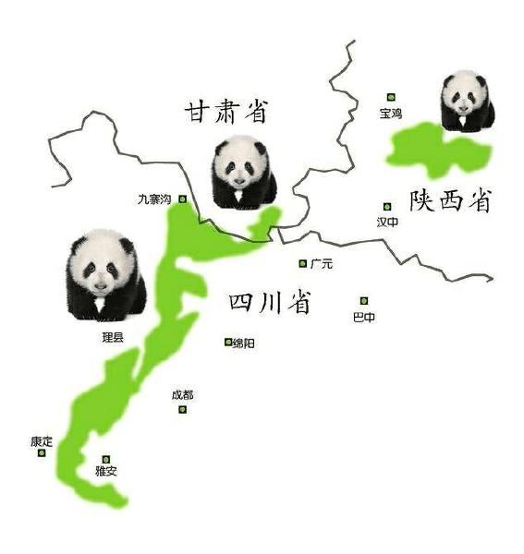
40.6 Some Biodiversity May Be Recoverable
As the human population continues to grow,pressure on natural resources will only increase.One key to reversing environmental decline will therefore be to slow the growth of the human population.In addition,although some species are gone forever, humans may have the power to undo some of our past mistakes.For example, thanks in part to the Endangered Species Act of 1973,some species that faced extinction,such as the bald eagle, have recovered.
A.Protecting and Restoring Habitat Saves Many Species at Once
One important conservation tool is to set aside parks,wildlife refuges,and other natural areas and to protect them from destruction, invasive species,and hunting.Preserving critical habitat is a good conservation tool because it saves not just one endangered species but also the many other species that share its habitat.

Slide 23
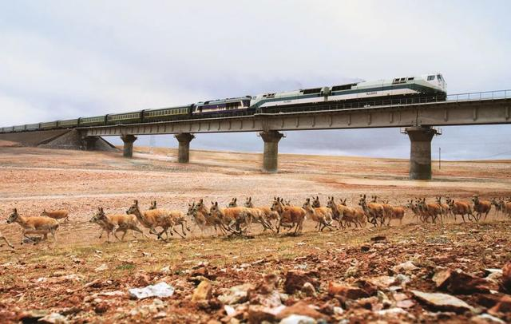
40.6 Some Biodiversity May Be Recoverable
As the human population continues to grow,pressure on natural resources will only increase.One key to reversing environmental decline will therefore be to slow the growth of the human population.In addition,although some species are gone forever, humans may have the power to undo some of our past mistakes.For example, thanks in part to the Endangered Species Act of 1973,some species that faced extinction,such as the bald eagle, have recovered.
A.Protecting and Restoring Habitat Saves Many Species at Once
Reversing habitat destruction is a second conservation tool.Major restoration projects,such as the Everglades plan described in this chapter's opening essay,show that recovery,although costly and difficult,may yet reverse some species declines.Bioremediation,a strategy that uses plants and microbes to clean up polluted soils,may also play a role in some cases.

Slide 24
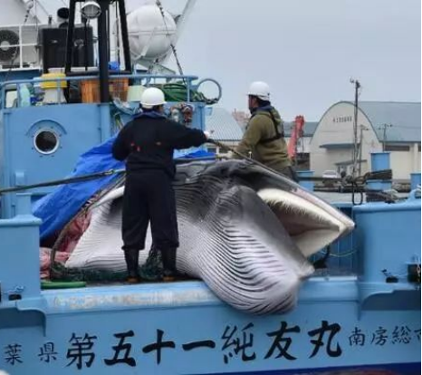
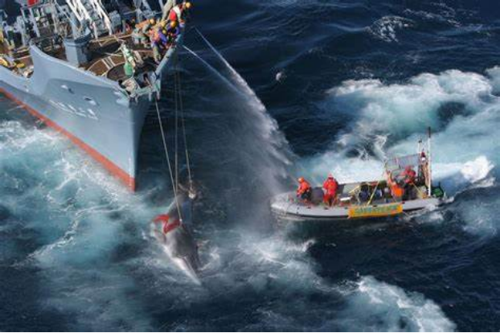
40.6 Some Biodiversity May Be Recoverable
B.Some Conservation Tools Target Individual Species
One straightforward way to save a species is to protect its individuals.For example,it is illegal to collect endangered carnivorous plants such as Venus flytraps and pitcher plants in the wild. In the ocean,northern and southern right whales were nearly hunted to extinction for their blubber in the 1800s.They remain endangered, but it is now illegal to kill them.

Slide 25
40.6 Some Biodiversity May Be Recoverable
Predator control programs can also help.For example,rats,weasels,dogs,and other predators transported by European settlers endanger the great spotted kiwi,a flightless bird native to New Zealand.Removing these predators from nature preserves has made life much easier for the endangered kiwis.Conversely,restoring prey populations can help endangered predators.
In areas where wildlife poaching（偷猎） is a problem,changing the local economic incentives can be a powerful conservation tool. Poaching is profitable if a dead animal is worth more money than a live one in its natural habitat. But ecotourism can turn this economic calculation on its head.By attracting visitors who pay to see endangered animals,conservation may bring in more money than poaching. A black rhino conservation program in Namibia,for example,hires former poachers as armed guards who protect the animals from hunters.Meanwhile,guides lead tourists hoping to spot a rhino in the wild .
Protective laws and predator control programs may help halt the decline of a threatened species, but sometimes it is possible to boost reproduction as well.A captive breeding program can be very useful. Biologists can capture adults from the wild, allow them to reproduce in captivity,then nurture and protect the young until they are old enough to return to their native habitat.
The biotechnology revolution plays a role in yet another approach to species conservation.In one project, researchers are using DNA to identify bison whose genes are uncontaminated with those of domesticated cattle.

Slide 26
40.6 Some Biodiversity May Be Recoverable
C. Conserving Biodiversity Involves Scientists and Ordinary Citizens
Regardless of which tools are used to preserve biodiversity,all conservation efforts require a scientific approach.To get a true measure of Earth's biodiversity,taxonomists must catalog all organisms,not just vertebrates and plants.Evolutionary biologists must continue to analyze the relationships among all species.Preserving biodiversity also requires an understanding of which species need help,whether current conservation efforts are working,and the consequences to ecosystems as species disappear.

Slide 27
FIGURE IT OUT
Which strategy would be most likely to restore over exploited ocean species with the least potential for harm to the ecosystem?
a.Eating only farmed seafood
b.Dumping nutrients into the ocean to increase primary production
c.Passing regulations that limit harvests
d.Adding invasive species to increase competition in aquatic food webs

